Slide 1
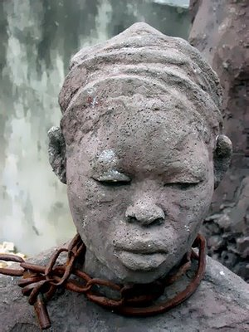
The Atlantic Slave Trade
Credit given to: Holt, Rinehart, and Winston Publishing for portions of this presentation

Slide 2
The Atlantic Slave Trade
Main Idea
Between the 1500s and the 1800s millions of Africans were captured, shipped across the Atlantic Ocean, and sold as slaves in the Americas.
Reading Focus
Where did the Atlantic slave trade originate?
How did slavery evolve in the American colonies?
What were the consequences of the slave trade?

Slide 3
Origins of the Slave Trade
Slavery has existed in many parts of the world
People forced into slavery came from different walks of life
Farmers, merchants, priests, soldiers, or musicians; fathers and mothers, sons and daughters.
Beginnings
Native Americans
African Slaves
Shortage of labor in Americas led to beginning of Atlantic slave trade
European planters needed workers on sugar, tobacco plantations
Planters first used Native Americans; European diseases killed millions
1600s, used indentured servants
Expensive to support workers
Millions forcibly taken to Americas
Most from coast of West Africa
Some exchanged for firearms, goods
Others kidnapped on raids by traders

Slide 4
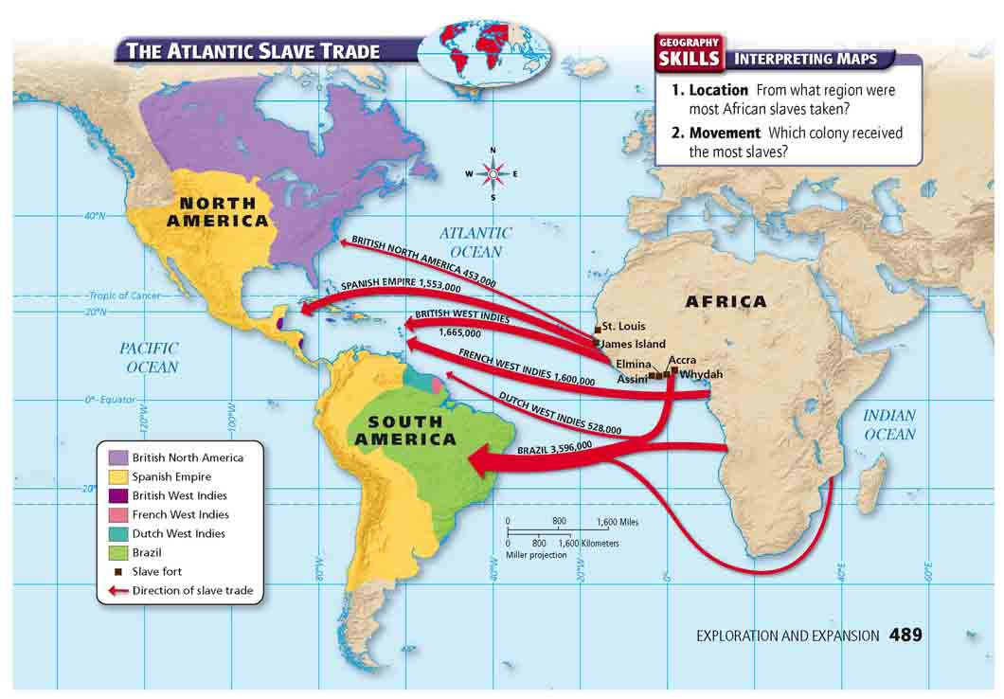
Slave Trade Destinations

Slide 5
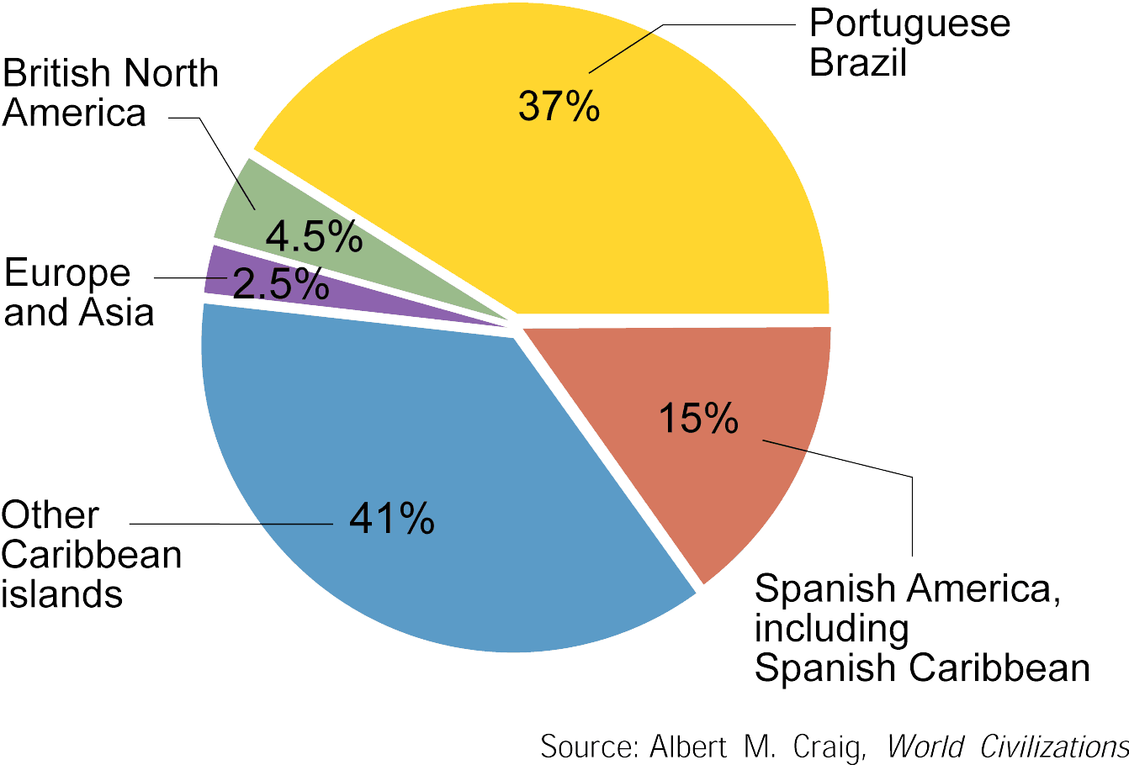
Slave Trade Destinations

Slide 6
Trade Network
Captured Africans became part of a network called the triangular trade:
First leg of triangle - ships carried European goods to Africa to be exchanged for slaves.
Second leg - Middle Passage - Africans were brought to the Americas to be sold.
Third leg - American products were carried to Europe.
Some slave traders from Americas sailed directly to Africa, not following triangular route

Slide 7
Triangular Trade

Slide 8
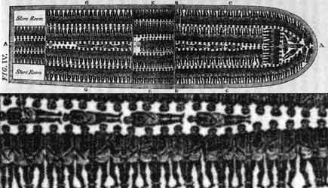
Middle Passage
Middle Passage, terrifying ordeal
Captive Africans chained together, forced into dark, cramped quarters below ship’s decks
Could neither sit nor stand
Journey lasted three to six weeks. Ten to twenty percent did not survive

Slide 9
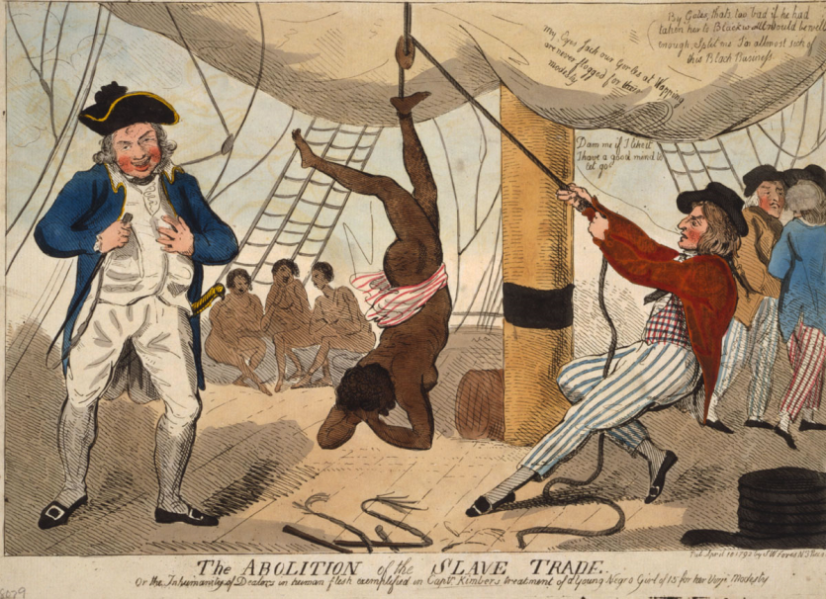
Middle Passage
Horrific Conditions
Olaudah Equiano wrote about conditions on slave ship:
“The stench of the hold…was so intolerably loathsome, that it was dangerous to remain there for any time…
“The shrieks of the women, and the groans of the dying, rendered the whole scene of horror almost inconceivable.”

Slide 10
The Slave Trade – Video Clip from Amistad
Amistad is a 1997 film directed by Steven Spielberg based on the true story of a slave mutiny that took place aboard a ship of the same name in 1839 (Quote from Wikipedia).

Slide 11
Summarize
What was the Middle Passage of the slave trade like?
Analyze
Why were some people willing to treat others in this way?
Respond
What is your reaction to this clip?

Slide 12
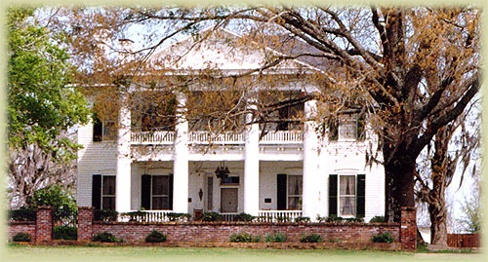
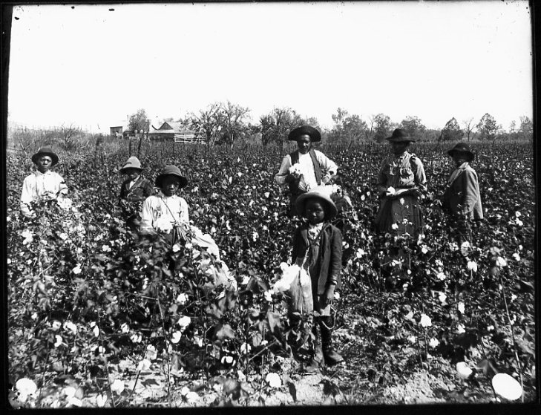
Slavery in the Colonies
Slave traders carried captive Africans throughout the Americas
Spanish—Caribbean sugar plantations; Portuguese—Brazil; English—West Indies but also to colonies in North America.
England dominated the slave trade by end of 1600s
Jobs
Most slaves worked on plantations
Others worked in mines, in towns, in the countryside
Skilled craft workers—carpenters, metalworkers, coopers—continued crafts in Americas
Women given domestic duties

Slide 14
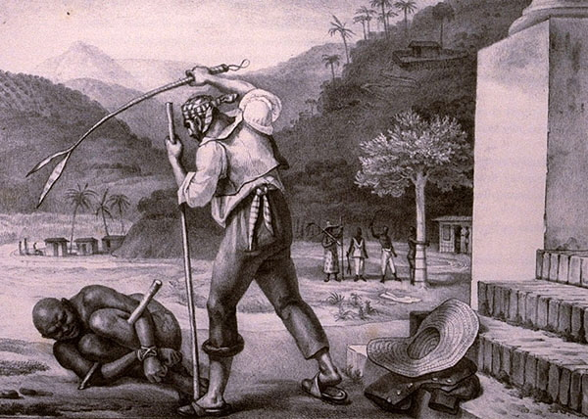
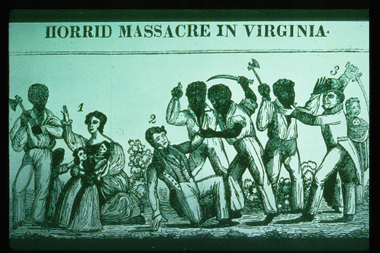
Slavery in the Colonies
Living Conditions
Slaves had to meet own basic needs at end of workday
Cooking, mending, tending the sick fitted in around work for slaveholder
Living conditions harsh
Physical, degrading punishment inflicted for minor offenses
Many slaveholders lived in constant fear of rebellion by angry slaves who could no longer take harsh treatment they faced on plantations.

Slide 15
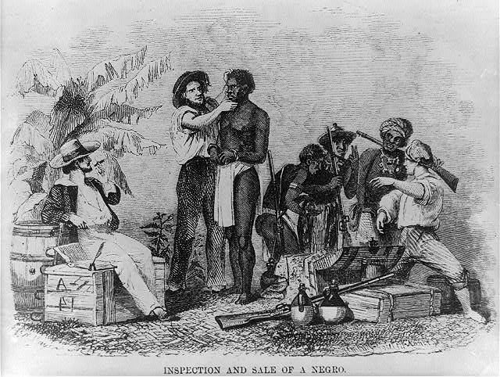
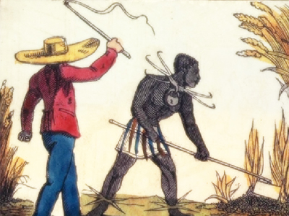
Property
Laws in Americas considered enslaved Africans to be property
Slaves had no rights, freedoms
Slaveholders controlled most conditions under which they lived
Often enslaved people endured brutal treatment, abuse

Slide 16
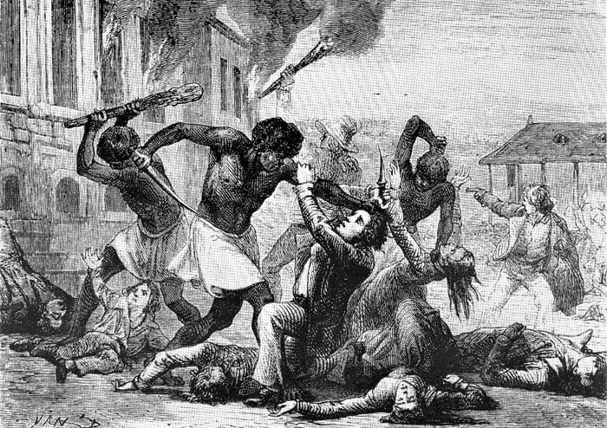
Resistance
Slaves coped with inhumane conditions many different ways
Some resisted by trying to keep cultural traditions alive
Others turned to religion for strength, hope
Some fought back by slowing work, destroying equipment, revolting
Some able to flee, establish communities of runaways

Slide 17
Summarize
Why did many slaves fight back against their owners?
Respond
What would you have done if you were a slave?

Slide 18
Effects of the Slave Trade
400 years of Atlantic slave trade
Devastated West African societies
Effect: Human Cost
Effect on Africa
Estimates of 15 to 20 million Africans shipped to Americas against their will
Millions more sent to Europe, Asia, Middle East
Human cost enormous
Countless died in transit
Millions deprived of freedom
Descendants doomed to lives of forced servitude
Effects profound in Africa
Slave raiders captured strongest young—future leaders of societies
Divided Africans one from another—some rulers waged wars to gain captives
Forced labor of millions of Africans did not enrich Africa

Slide 19
Summarize
What effects did the Atlantic slave trade have in Africa?
Speculate
What effect would the Atlantic slave trade have had in the Americas?

Slide 20
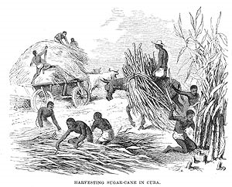
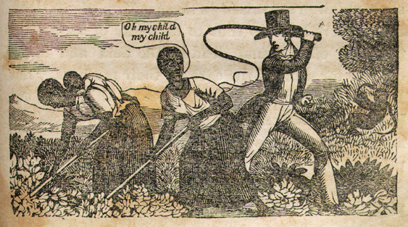
Effect: Economies
Forced labor of Africans did enrich other parts of world
Labor of African slaves built economies of many American colonies
Their knowledge of agriculture contributed to growth of rice industry in southern English colonies

Slide 21
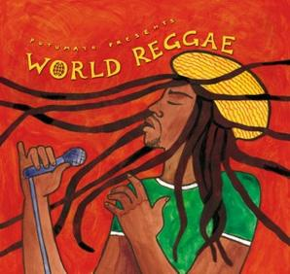
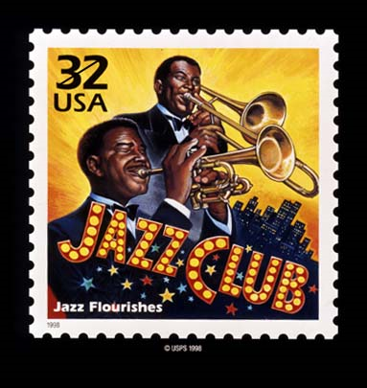
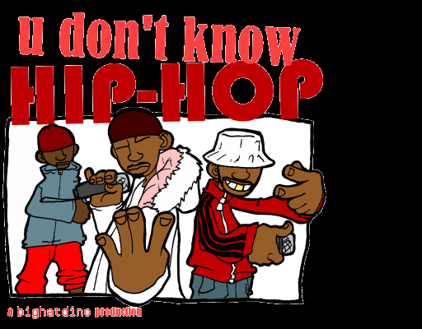
Effect: Spread of Culture
As result of slave trade, people of African descent spread throughout Americas, Western Europe
Spread called the African Diaspora
Eventually led to spread of African culture—music, art, religion, food—throughout the Western World

Slide 22
Exploration
Colonization
Columbian Exchange
New Economic Systems
Atlantic Slave Trade

