Slide 1
Medieval Europe

Slide 2
Feudalism
Manorial System –
Heart of medieval economy
Manor (lord’s estate) – included one or more villages and the surrounding lands
Generally self-sufficient (produce everything they needed)
Role of the Monarch –
Invasions by Vikings, Muslims, and Magyars → too weak to maintain order and law
Decentralized political structure – granted a fief (estate) exchange for loyalty and military service.
Status of Peasants –
Work the land in return protection
Most were serfs (bond to land)

Slide 3
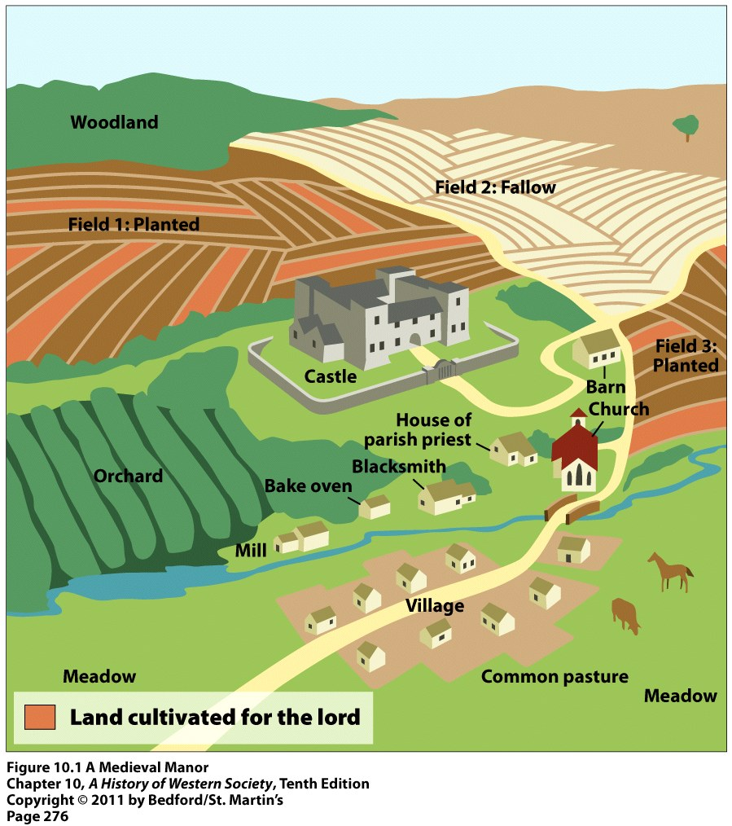
Three Field System – moved from two fields system → two of the fields were planted and the other lay fallow (unused) for a year.
Increased food production = growth in populations

Slide 4
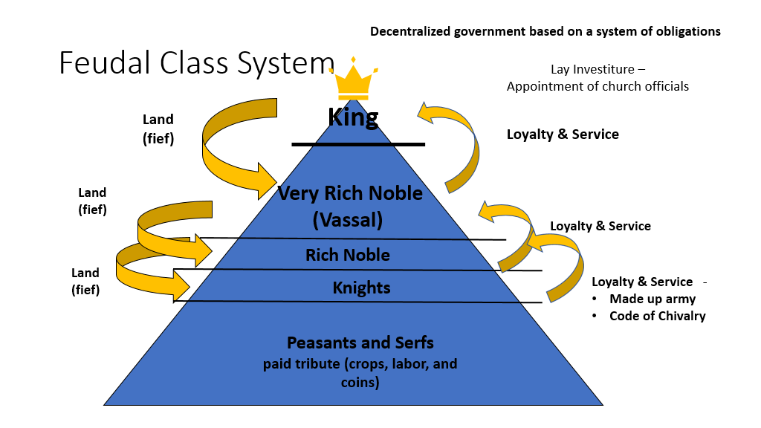

Slide 5
Charlemagne
Leadership –
Reigned for 46years
Spent much of his reign fighting Muslims in Spain, Saxons, Avars and Slaves and Lombards.
Doubled the sizes of the Frank kingdom
Appointed nobles to rule local regions
To control of these rulers he send out officials to on roads, listen to grievances, and see that justice was done.
Strove to create a united Christian Europe.
Religion and Education
Worked closely with the Church
Helped spread Christianity to the conquered peoples
Proclaimed Emperor of Romans by the Pope
Set out to revive Latin learning throughout his empire and encouraged the creation of local schools.
Brought many of the best scholars of Europe to the Palace School.
Curriculum included grammar, rhetoric, logic, geometry, music, etc.

Slide 6
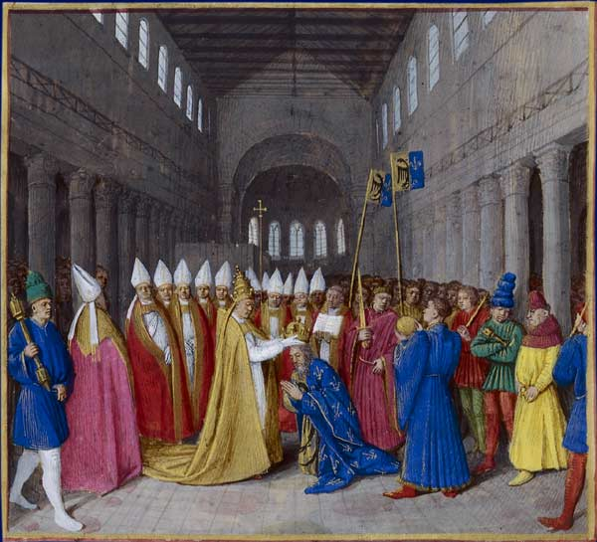
Charlemagne (continued)
Importance –
Extended Christian civilization into Northern Europe
Blended Germanic, Roman, and Christian traditions
Set-up a strong and efficient government

Slide 7
Changes in Medieval Society
Banking & Trade –
Most trade took place in towns
Cloth biggest trade item
Other items – bacon, salt, honey, cheese, wine, etc.
More goods- expansion of trade routes all over Europe
Traders - needed new ways to carry large amounts of money and ways to exchange currency
Bills of exchange establish exchange rates
Letters of credit eliminated the need to carry large amounts of money.
Banking became an important business (especially in Italy)
Learning & Rise of cities –
Trade was the lifeblood of the new towns
Cities were full of people and dirty
New institution – university
Scholars used the vernacular

Slide 8
Guilds –
An organization of individuals in the same business or occupation
Merchant Guilds- associations of merchants - regulated trade in towns
Encouraged fair business practices – exact quality standards, uniform prices etc.
Active in town government and functioned as social clubs.
Craft Guilds – association of skilled craftspeople
Apprentice → Journeyman → Master

Slide 9
Church
Role of the Church –
Pope was one of the most powerful leaders in Western Europe
Church administered the sacraments
Developed Canon law (church law) and even had its own courts.
Political impact - Pope Gregory VII & King Henry IV
Issue – lay investiture – the appointment of religious officials by kings or noble.
Gregory VII banned lay investiture in 1075.
Henry IV ordered Gregory to step down from the papacy and Gregory VII excommunicated Henry IV.
Concordat of Worms (1122)– Church could elect and invest bishops with spiritual authority bishops but the emperor invested them with fiefs.

Slide 10
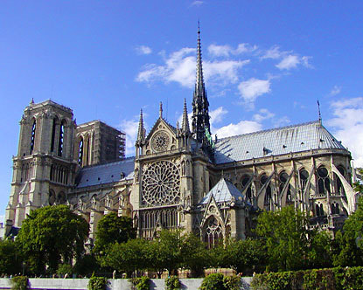
Cathedrals –
New style of architecture – Gothic
Stained glass windows, ribbed vaults, flying buttresses, pointed arches etc.
Meant to inspire worship
Example – Notre Dame

Slide 11
Crusades
Call for Crusades –
The Byzantine Emperor wrote a letter for help against the Muslim Turks in 1093 → Pope Urban II issued a call to gain control of the Holy Land.
Brought a tremendous outpouring of religious feeling and support for the Crusade.
Crusades (1,2,3,4) –
1st Crusade -
Most Crusaders – French
Ill-prepared for war (knew nothing about the geography, climate, or culture)
Won a narrow strip of land but Turks regain land.
2nd Crusade –
Recapture land but were defeated and Saladin took Jerusalem
3rd Crusade -
Kings Crusade – led by Richard the Lion-Hearted
Saladin and Richard agreed to a truce in 1192
4th Crusade –
Knights did not reach the Holy Land but looted Constantinople

Slide 12
Impact of the Crusades on the Islamic World –
Left a bitter legacy of religious hatred (both sides committed appalling atrocities)
Jerusalem
Effects of the Crusades in Europe –
increase in trade
cultural diffusion
Byzantine Empire weakened
Turned against the Jews
legacy of bitterness/hatred
decline of feudalism
lessened power of pope
Exploration

Slide 13
Plague
Origin –
Began in Asia
Followed trade routes
Black rats carried infected fleas
Effects –
Trade declined, prices rose
Town populations fell (1/3 of Europe’s population was wiped out)
Jews were blamed for the plague
Church suffered a loss of prestige
Plague symptoms –
Painful swelling in the lymph nodes (armpit and groin) called buboes.
Purplish or blackish spots on the skin
Extremely high fever, chills, delirium, and in most cases death.

