Slide 1
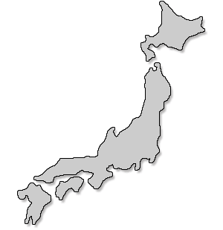
Japan
Chapter 19

Slide 2
1400-1500s
“Warring States”
Period of turmoil
Shogun was a mere figurehead
Emperor performed religious functions
Daimoys who controlled their own land and waged war against other feudal lords.

Slide 3
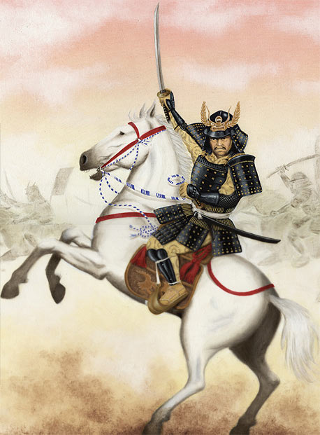
Daimyo
“Great Name”
Warrior chieftains
Lord in Japanese feudalism

Slide 4
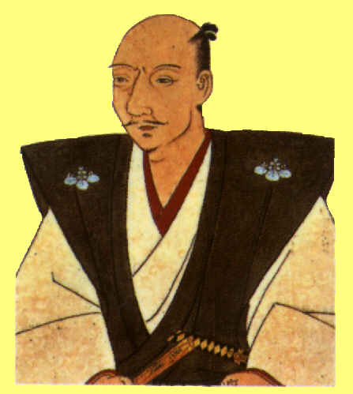
Oda Nobunaga
Brutal and ambitious
First military leader to begin the unifying the warring daimyos.
Unable to united Japan
Seized the imperial capital in 1568
He committed a ritual suicide (seppuku) in 1582.

Slide 5
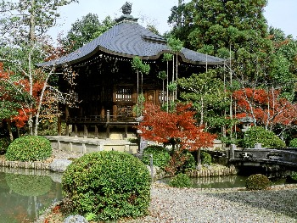
Kyoto
Imperial Capital
The emperor served as a figurehead

Slide 6
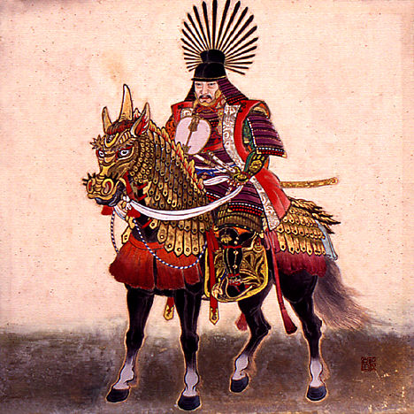
Toyotomi Hideyoshi
One of Nobunaga’s best generals
By 1590, with political alliances, he controlled most of the country.
Wanted to conquer China
In 1592 he invaded Korea.
He died in 1598.
His troops withdrew from Korea.
Tokugawa Ieyasu was his strongest daimyo allies.

Slide 7
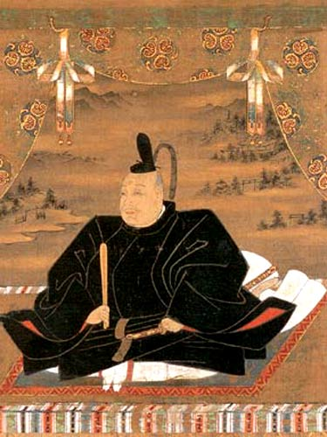
Tokugawa Ieyasu
Completed the unification of Japan at the Battle of Sekigahara.
Shogun of Japan in 1603
Moved the capital to Edo.
Used the “alternate attendance policy” to control daimyo.
Founded the Tokugawa Shogunate.
Held power until 1867. (265 years)

Slide 8
“Alternate attendance policy” Sankin Kotai
Method of taming the Daimyo
Required Daimyo to spend every other year in the capital (Edo).
Had to pay tribute and services to the shogun for a full year.
A major step towards restoring centralized government in Japan.

Slide 9
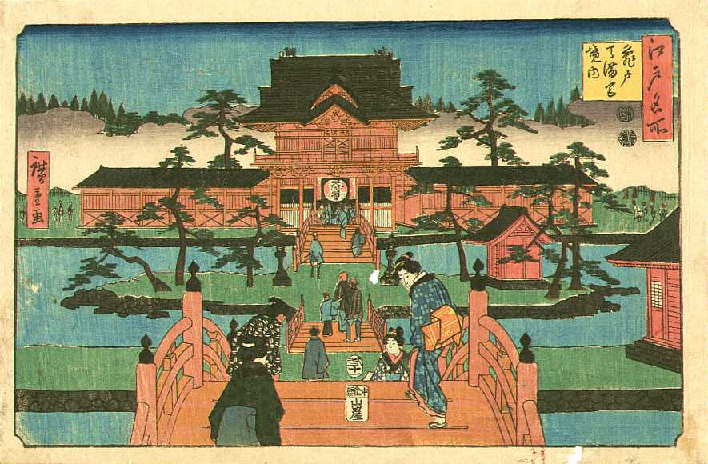
Edo
Shogun Capital
Ieyasu - Government headquarters
Small fishing village
Modern day – Tokyo

Slide 10
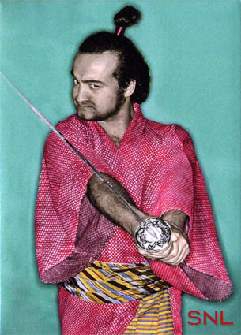
Social Classes
Daimyos and Samurai (could wear symbols of authority – topknot in their hair and a sword)
Farmers – major food producer
Artisans – made goods
Merchants – not productive (just exchanged goods)

Slide 11
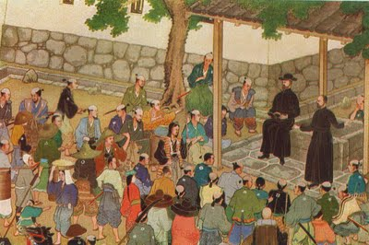
Francis Xavier
Jesuit who led the first mission to Japan
Helped to spread Christianity in Japan
By 1600 there where about 30,000 Japanese Christians

Slide 12
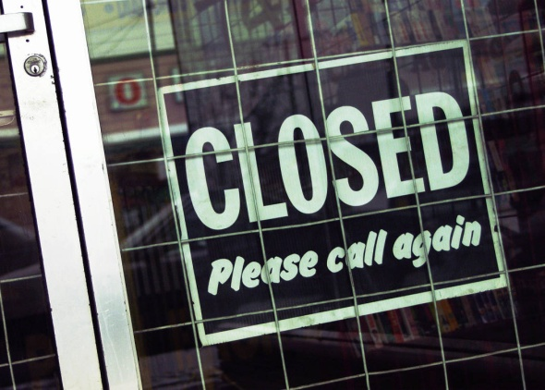
Isolation
Tokugawa rulers decided contact with foreigners was too dangerous
By 1639, they had sealed Japan’s borders and instituted a “closed country policy”
Foreign trade was only allowed at one port.
Shoguns had a monopoly on foreign trade.
Remained isolated for more than 200 years.

Slide 13
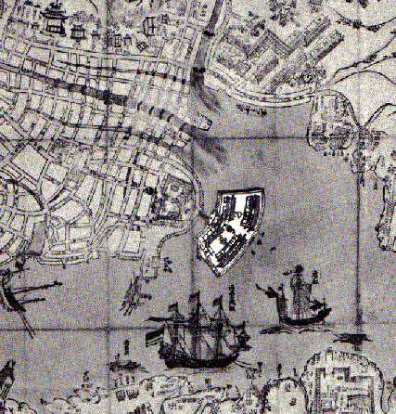
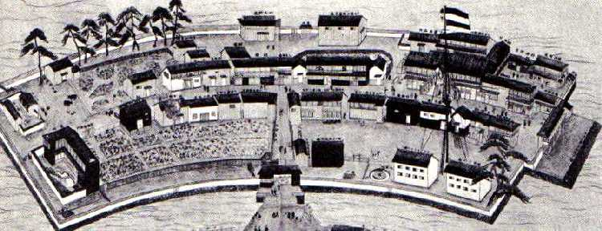
Nagasaki
Trade was only open to Dutch and Chinese merchants.
Shoguns controlled Nagasaki

